Slide 1
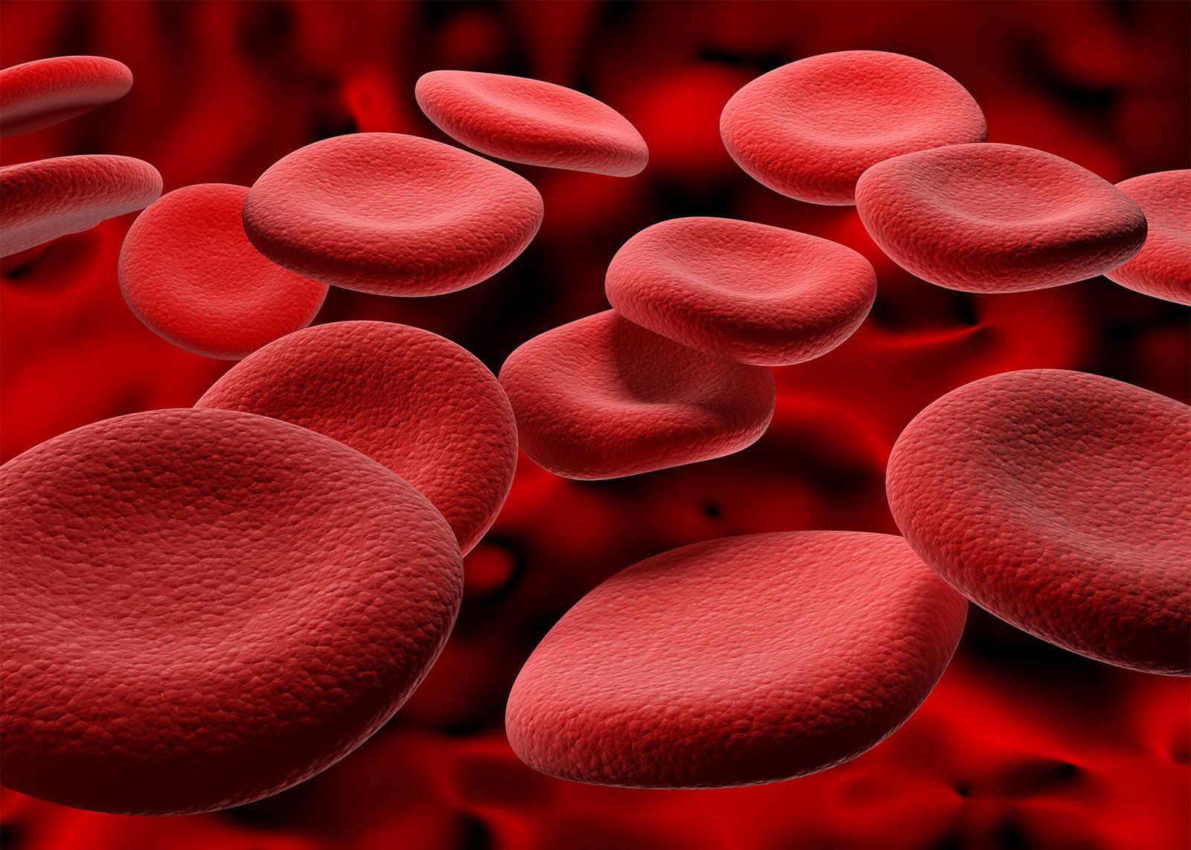
BLOOD DONATION MANAGEMENT SYSTEM

Slide 2
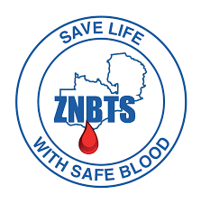
1) INTRODUCTION
Blood transfusions are a cornerstone of modern medicine, saving countless lives every year. However, a persistent challenge plagues healthcare systems globally: blood shortages.
In Zambia, the Zambia National Blood Transfusion Service (ZNBTS) operates from the University Teaching Hospital, serving as the largest blood transfusion facility in the country. Despite it being supported by nine regional centers and 132 blood banks spread across Zambia, these challenges are particularly pronounced.
This proposal explores the development of a Blood Donation Management System (BDMS), a web-based solution designed to revolutionize blood donation. And Its main aim will be to ultimately increase access to safe blood transfusions for patients in need.

Slide 3
1.1) Background
Blood donation and blood banks play critical roles in healthcare systems worldwide, but they also face various challenges these include:
Maintaining an Adequate Blood Supply (Primary Challenge)
Recruitment of Donors: especially among certain demographic groups such as young adults, minorities, and individuals with busy lifestyles
Managing Blood Shortages
Logistical and Operational Challenges: Blood banks must manage complex logistical and operational processes, including blood collection, testing, processing, storage, and distribution. This requires robust infrastructure.
Educating the Public: There may be misconceptions or lack of awareness about blood donation and its importance

Slide 4
Background Continued…
According to the World Health Organization (WHO), blood shortages are a persistent global challenge. This scarcity can be attributed to several factors including:
Limited Donor Pool
Inefficient Management Systems: Traditional paper-based blood donation management systems.
Poor Communication and Coordination: Disconnected communication channels between blood banks, hospitals, and potential donors can hinder the efficient allocation of blood resources.
The BDMS is proposed as a solution to address these shortcomings and create a more efficient and reliable blood donation system.

Slide 5
1.2) Problem Statement
Current blood donation processes are characterized by:
Manual and paper-based recordkeeping, leading to errors and delays.
Limited communication and coordination between blood banks, hospitals, and potential donors.
Difficulty for potential donors to discover nearby donation opportunities and schedule appointments.
Ineffective tracking and management of blood inventory, hindering optimal resource allocation.
These shortcomings create a significant barrier.

Slide 6
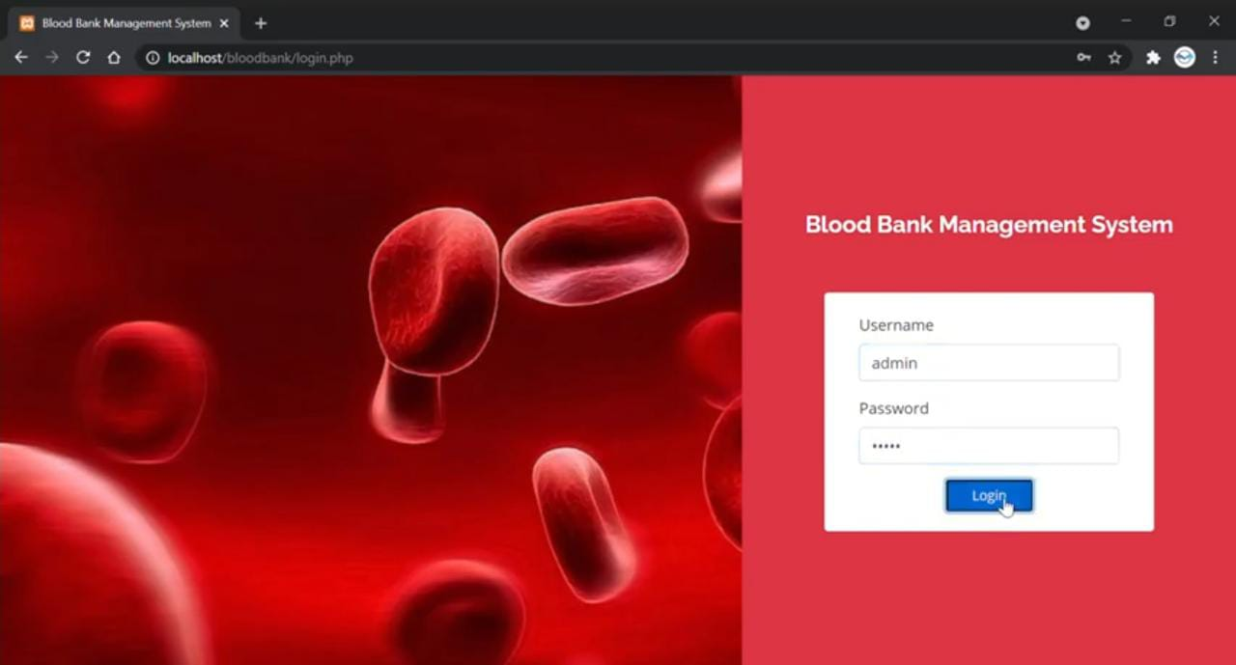
1.3) Research Question
Can a user-centered, web-based Blood Donation Management System (BDMS) address the shortcomings of traditional methods and significantly improve blood donation efficiency and accessibility?

Slide 7
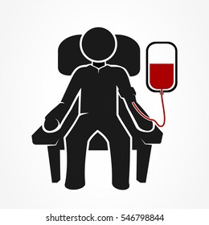
1.4) Aims
The primary aim of this project is to develop and implement a BDMS that:
Streamlines the blood donation process for both donors and healthcare facilities.
Enhances communication and coordination within the blood donation ecosystem.
Increases the accessibility of blood donation opportunities for potential donors.
The major aim of this system, will be to ensure there are no blood shortages, thereby, guaranteeing timely access to life-saving blood transfusions for all patients in need.

Slide 8
1.5) Objectives and Scope
Develop User-Friendly Web Application: Create separate interfaces for donors and healthcare facilities.
Integrate Key Functionalities: Include features for donor registration, blood request management, and appointment scheduling.
Real-Time Blood Supply Tracking: Develop a system for tracking blood supplies and locating nearby donation centers.
Secure Notification System: Implement a secure notification system to alert donors about urgent blood needs and schedule updates.
Ensure Data Security: Maintain data security and privacy through robust user authentication and authorization mechanisms.
The project scope encompasses the design, development, deployment, and initial user training for the BDMS.

Slide 9
3) LITERATURE REVIEW
To gain a deeper understanding of the field, a thorough literature review will be conducted that will:
Analyze existing blood donation management systems and identify their strengths and limitations.
Explore research on user-centered design principles in healthcare applications.
Investigate best practices for data security and privacy in web-based healthcare systems.

Slide 10
4) METHODOLOGY
The BDMS will be developed using an agile development methodology, characterized by:
Iterative development cycles with continuous user feedback integration.
User-centered design approach with active participation from stakeholders, donors, and healthcare professionals.
Requirement gathering through stakeholder interviews, surveys, and focus groups.
System prototyping and user testing sessions to ensure usability and functionality.

Slide 11
4.1) SYSTEM MODULES AND FEATURES
Based on the challenges identified in the blood donation and blood bank sector, the BDMS should have the following key features to address these challenges effectively:
Donor Management: Online registration, Profile management, Engagement tools.
Blood Request and Tracking: Online request submission, Real-time inventory tracking.
Communication and Alerts: Automated notifications, Two-way communication.
Operations Management: Appointment scheduling, Inventory tracking, Reporting and analytics.
Public Education: Educational resources, Community outreach.

Slide 12
Operating Model
The BDMS will operate as a centralized web-based platform accessible to both donors and healthcare facilities.
Donors can register, schedule appointments, and receive notifications through the BDMS portal.
Healthcare facilities can submit blood requests, track inventory, and communicate with donors in real-time.
The system will leverage automation and data analytics to streamline processes, improve efficiency, and ensure timely access to blood for patients in need.
Additionally, the BDMS will prioritize user experience, data security, and compliance with regulatory standards to maintain trust and confidence among stakeholders.

Slide 13

4.2) CENTRAL FEATURE (Geolocation-based Notifications)
To address the challenge of blood shortages and notify potential donors of urgent blood needs, the BDMS will incorporate a geolocation-based notification feature. This feature will selectively notify eligible donors within the vicinity of a blood donation center when there is a specific need for their blood type, either in normal circumstances or during emergencies.
Here's how this feature will operate:

Slide 14
Continued…
Geolocation Integration: Utilizes geolocation services to determine donor location or user-provided location.
Blood Type Matching: Matches donors with urgent blood needs based on compatibility.
Eligibility Criteria: Verifies donor eligibility based on age and medical history.
Notification Trigger: Triggers notifications to eligible donors within the donation center's radius for specific blood needs.
Selective Notification: Notifies only donors with matching blood types and within proximity to the donation center.
Response Mechanism: Enables donors to indicate willingness to donate through the platform.
Encouraging Participation: Promotes blood type testing and eligibility screening for unsure users, with educational resources and incentives provided to encourage participation.

Slide 15

4.3) SCHEDULE
Requirement Gathering and Analysis (Weeks 1-2, 21st Apr – 4th May)
System Design and Prototyping (Weeks 3-6, 5th May – 1st June)
Development (Weeks 7-14, 2nd June – 27th July)
Testing and Quality Assurance (Weeks 15-16, 28th July – 10th August)
Deployment and User Training (Weeks 17-18, 11th August – 24th Aug)
Launch and Rollout (Week 19, 25th August – 31st August)
Post-Launch Support and Maintenance (Ongoing)

Slide 16
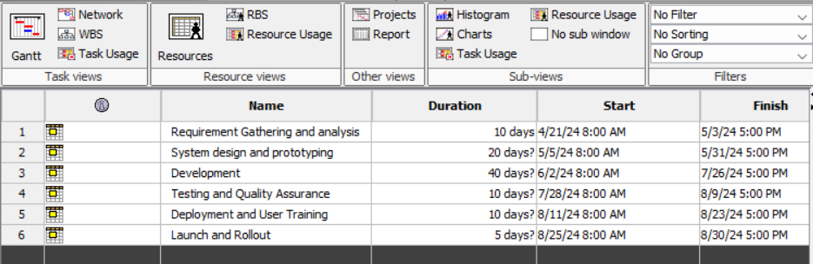
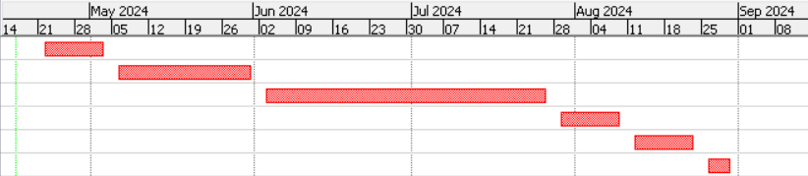

Slide 17
6) EXPECTED OUTCOMES
The successful implementation of the BDMS is anticipated to yield the following positive outcomes:
Streamlined Blood Donation Process: The online platform will simplify blood donation registration, appointment scheduling, and blood request management, reducing administrative burdens for both donors and healthcare facilities.
Increased Donor Pool: Improved accessibility through online registration and location-based search functionalities are expected to attract a wider pool of potential donors.
Enhanced Communication and Coordination: Real-time communication features will facilitate efficient blood request fulfillment and improve response times to urgent blood needs.
Improved Blood Inventory Management: The BDMS will provide healthcare facilities with a real-time view of blood inventory levels, enabling better resource allocation and preventing potential shortages.
Data-Driven Decision Making: Comprehensive blood donation data will be collected and analyzed, empowering stakeholders to make informed decisions regarding blood donation outreach programs and resource allocation.

Slide 18
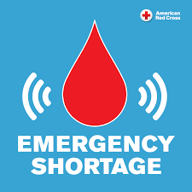
Continued…
All the above positive outcomes will lead to the main objective which is:
Elimination of Blood Shortages: The implementation of the BDMS is anticipated to lead to the elimination of blood shortages by optimizing blood donation processes, enhancing donor recruitment and retention strategies, and improving communication and coordination between blood banks and healthcare facilities. This outcome will ensure timely access to life-saving blood transfusions for all patients in need, thereby significantly enhancing healthcare outcomes and saving lives.

